Slide 1

Ogtip project 2 - Oeson
Fabio Mongillo

Slide 2


Analysis of job salaries
Using a dataset extracted from a famous job portal that explains the job status of various data-related jobs posted during the year 2023.
Through this data I will show the various job designations and related salaries across the world. I will extract meaningful insight, that will help recruiters understand the job requirements better in term of salaries across different levels of work experience so that they can get proficient profiles for any data-related requirement.

Slide 3


Data Description
work_year: The year in which the data was recorded. This field indicates the temporal context of the data, important for understanding salary trends over time.
job_title: The specific title of the job role, like 'Data Scientist', 'Data Engineer', or 'Data Analyst'. This column is crucial for understanding the salary distribution across various specialized roles within the data field.
job_category: A classification of the job role into broader categories for easier analysis. This might include areas like 'Data Analysis', 'Machine Learning', 'Data Engineering', etc.
salary_currency: The currency in which the salary is paid, such as USD, EUR, etc. This is important for currency conversion and understanding the actual value of the salary in a global context.
salary: The annual gross salary of the role in the local currency. This raw salary figure is key for direct regional salary comparisons.
salary_in_usd: The annual gross salary converted to United States Dollars (USD). This uniform currency conversion aids in global salary comparisons and analyses.
employee_residence: The country of residence of the employee. This data point can be used to explore geographical salary differences and cost-of-living variations.
experience_level: Classifies the professional experience level of the employee. Common categories might include 'Entry-level', 'Mid-level', 'Senior', and 'Executive', providing insight into how experience influences salary in data-related roles.
employment_type: Specifies the type of employment, such as 'Full-time', 'Part-time', 'Contract', etc. This helps in analyzing how different employment arrangements affect salary structures.
work_setting: The work setting or environment, like 'Remote', 'In-person', or 'Hybrid'. This column reflects the impact of work settings on salary levels in the data industry.
company_location: The country where the company is located. It helps in analyzing how the location of the company affects salary structures.
company_size: The size of the employer company, often categorized into small (S), medium (M), and large (L) sizes. This allows for analysis of how company size influences salary.

Slide 4

Visualization models that we will see:
• Frequency of each year
• Average Salaries for each year
• Frequency of job titles
• The top 10 most common data jobs
• Average salaries by job titles and the top job_titles with highest average salaries and least average salaries
• Average Salaries for the most common job titles
• Distribution of job categories
• Average Salaries by Job Category
• Average salary in usd based on currency
• Average salary based on employee residence and company location
• Salary based on experience level
• Average salary based on employment type, work setting and company_size

Slide 5
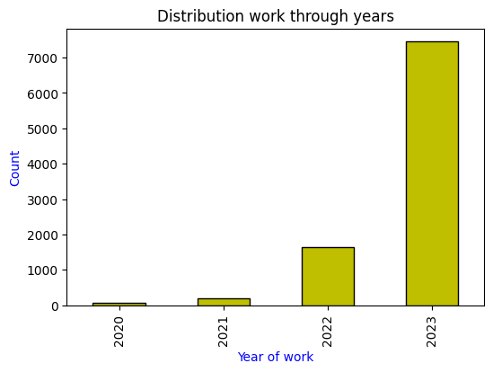
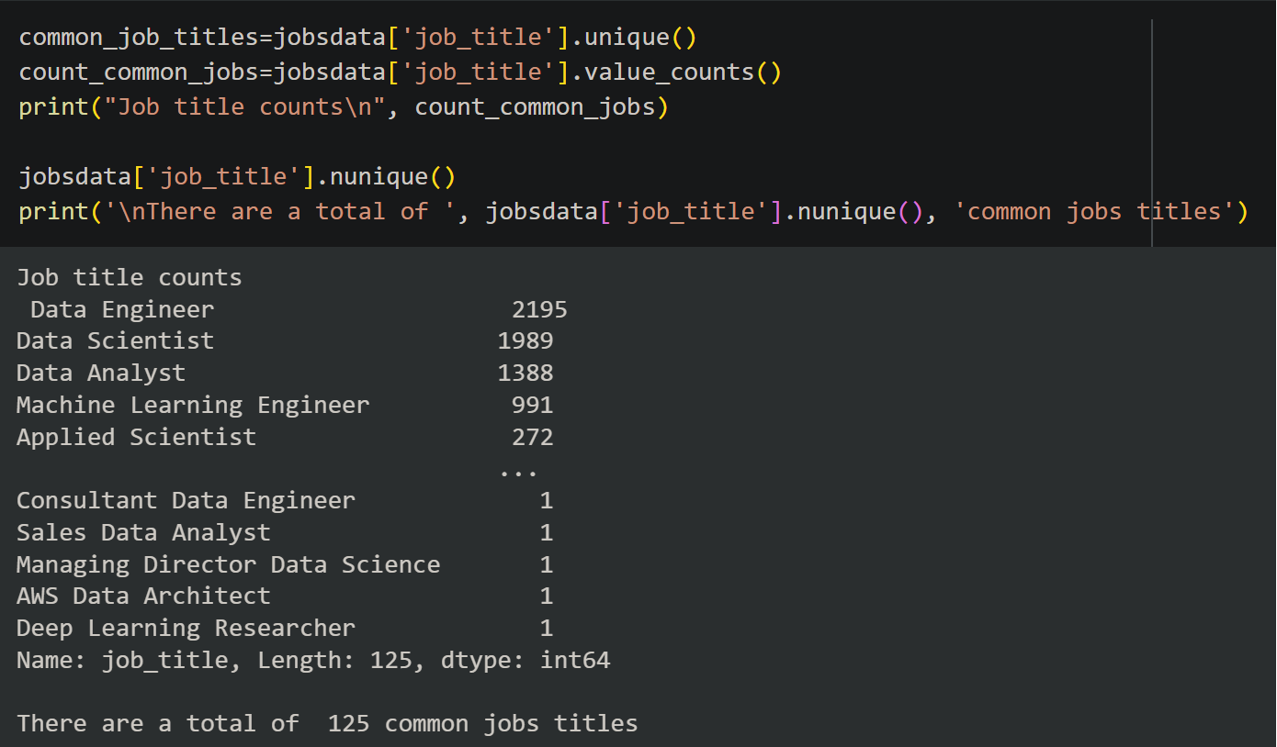
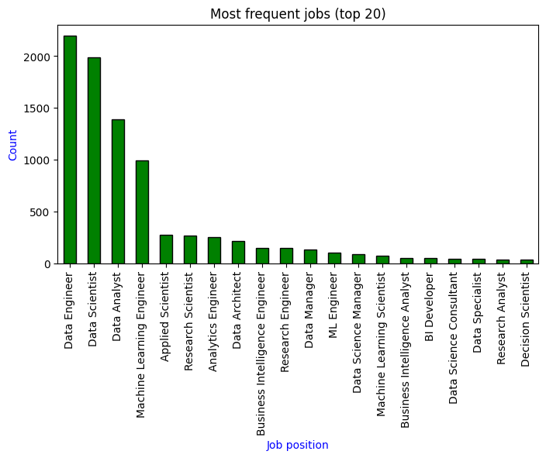
Visualization models
Here we can see some insights visualized using some python libraries.
In the first image, we can tell the number of jobs in the data field grow considerably, particularly in the last year.
In the second(on the right), an example of the code that recollects the total of the common job titles.
In the third we can see the top 20 most common job titles.

Slide 6

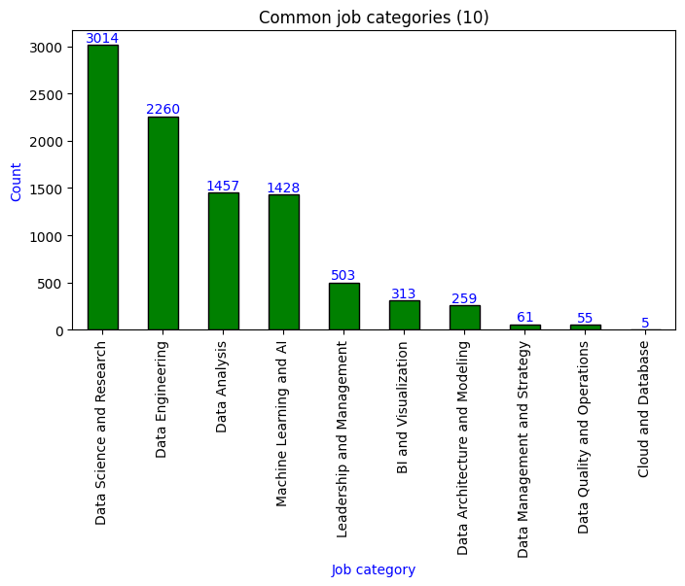
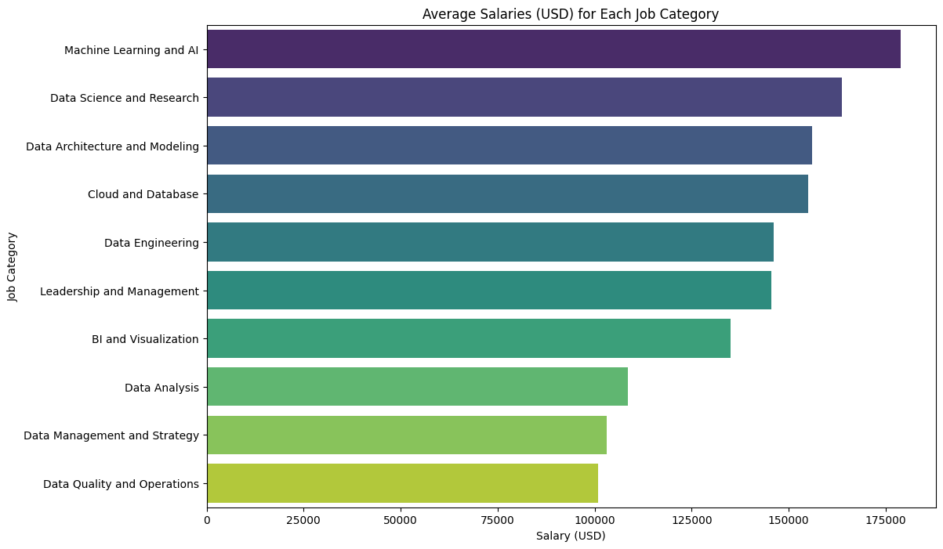
Job categories and average salaries by job category
Here we can see the most recurring job categories in the field of data
In this visualization, we extracted the salaries in USD by job category

Slide 7

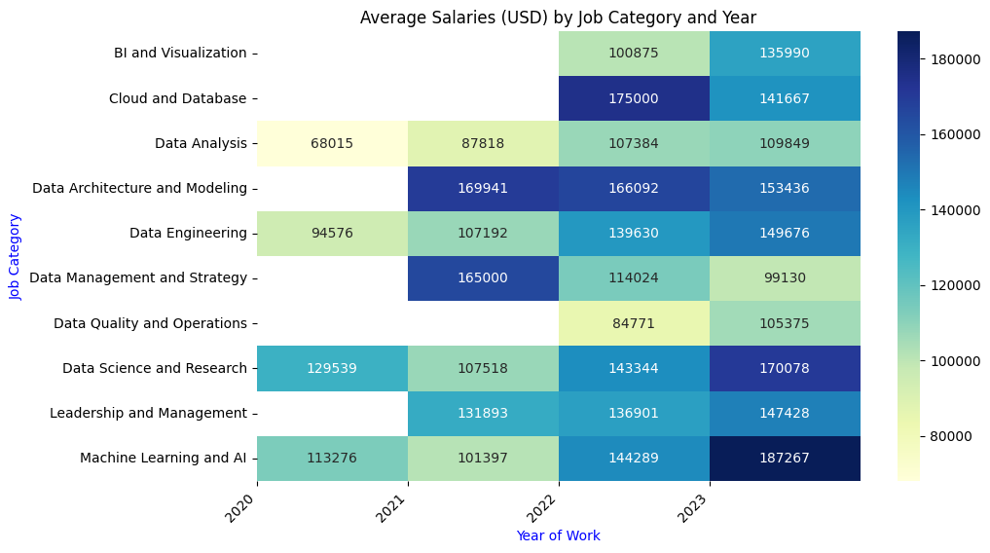
Average salaries by job category and year
I went a bit beyond analyzing average salaries for each job category and by year

Slide 8
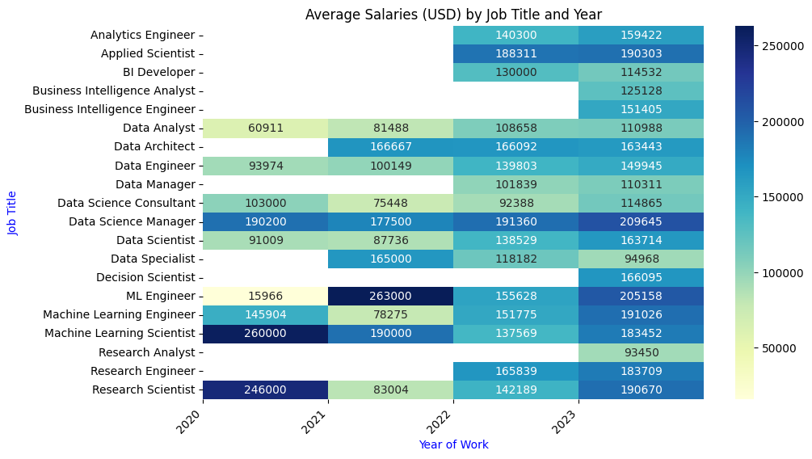
Average salaries by job titles and year
Here we analyze average salaries for each job title and by year, for the top 20 most frequent job titles. The heat map helps to understand well the distribution.

Slide 9
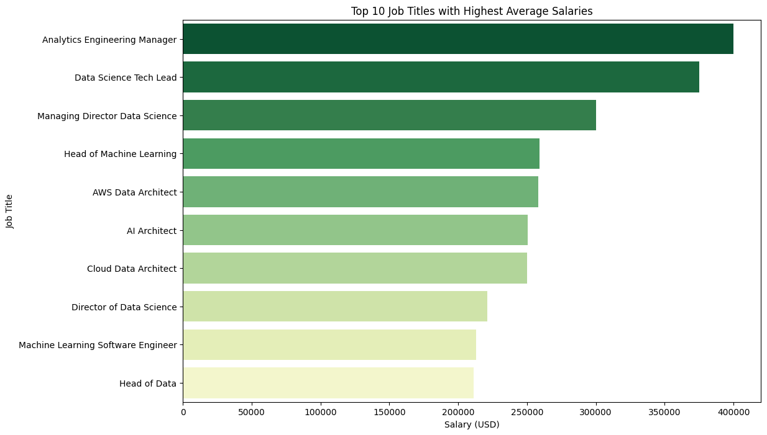
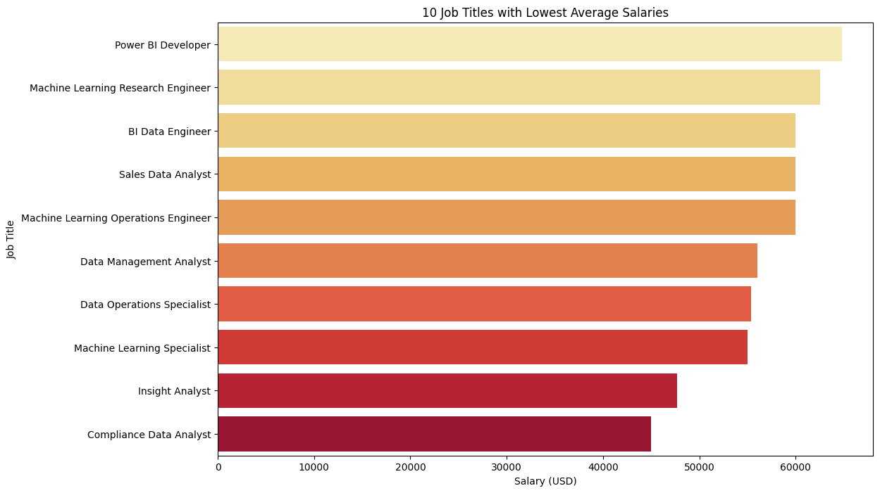
Highest and lowest average salaries for job titles (top 10)

Slide 10
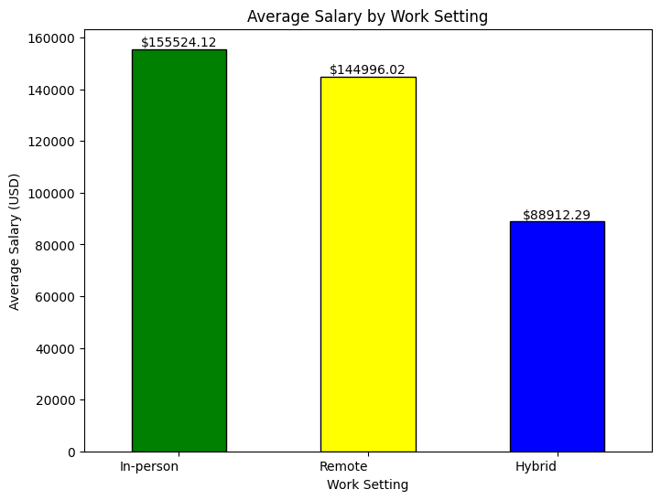
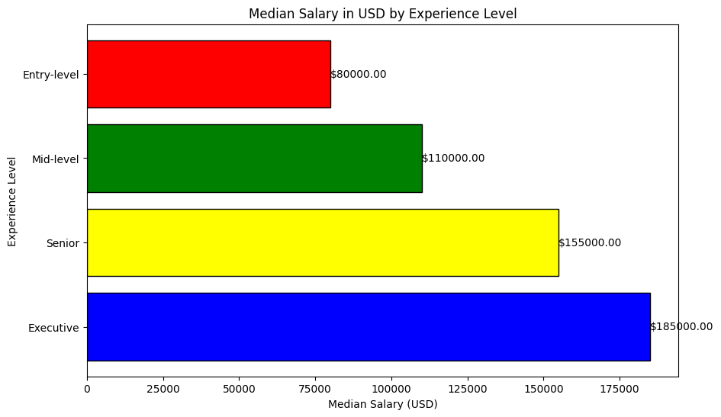
Salary by experience and work setting

Slide 11
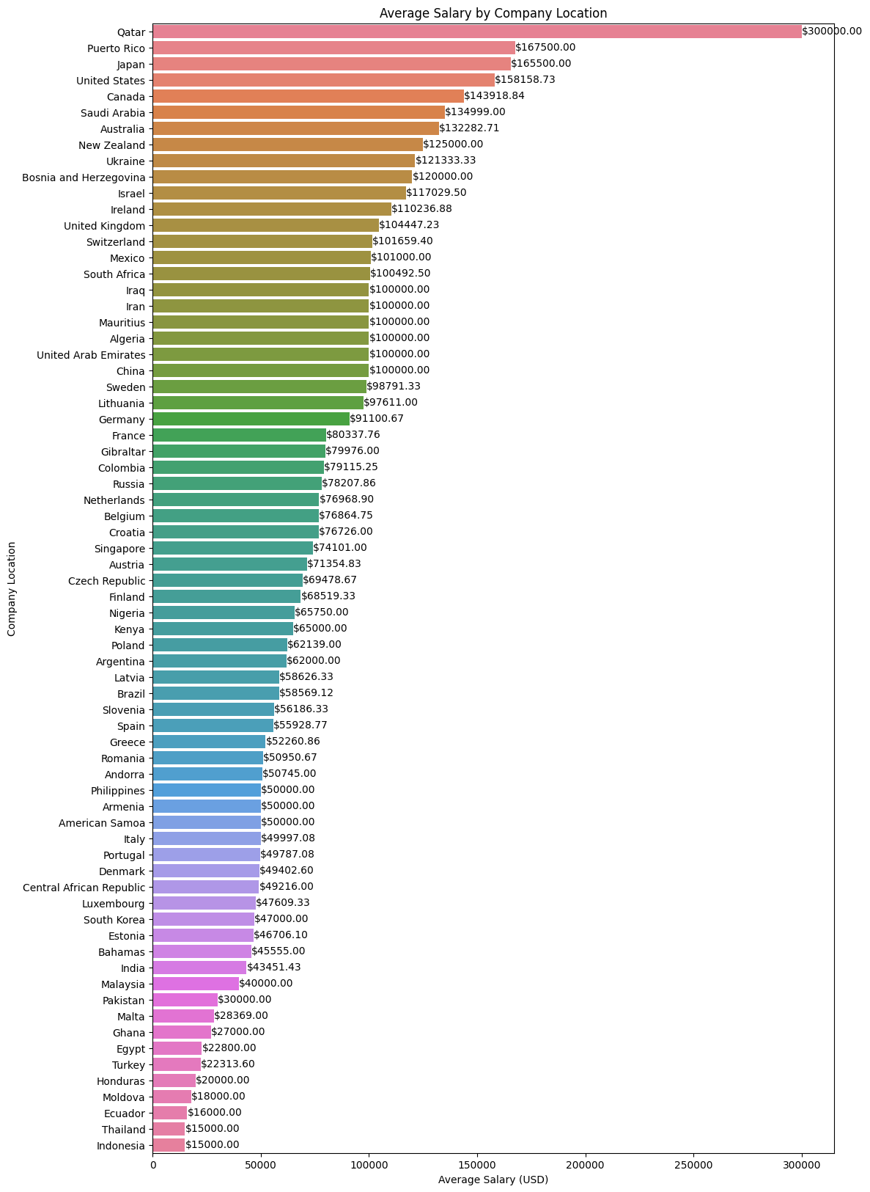
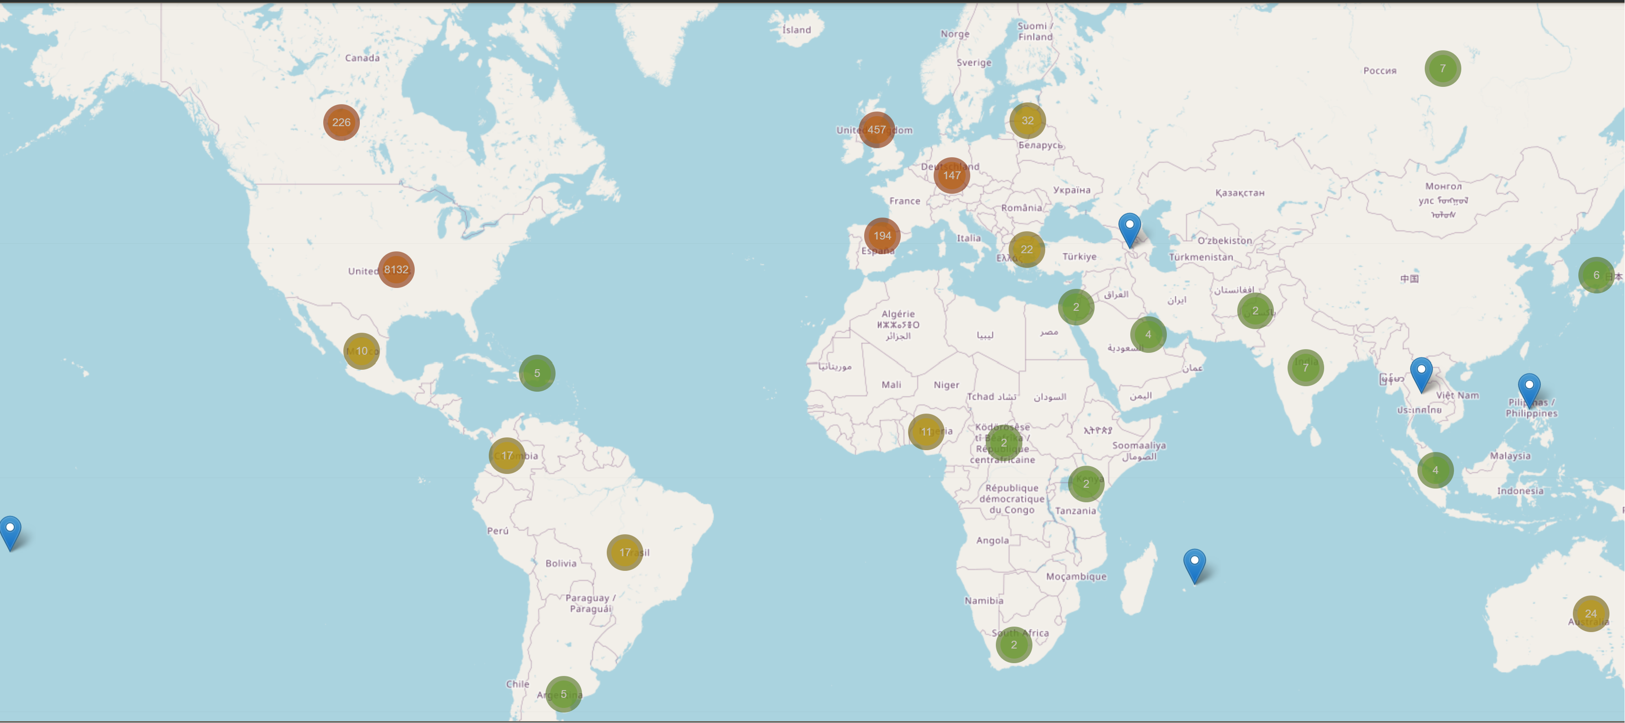
Company locations
Here a visualization of the company locations and the relative average salaries. Most of the company are based in US, although I think the results might be biased from the data of the portal job that had mostly information from US.

Slide 12




Summary
There are more visualization that I realized, and for more of them to analyze or the code I used for this analysis is it enough to visit my github link or profile that you will see on the next slide.
Regarding the results, it seems that the salaries are higher for those new figures like machine learning or related to AI since the development and advent of more advanced AI.
Most of the jobs are full time, while in terms of location we see there is an equal distribution of work on-site or remote.
The experience level as predicted is a factor that influences the salary. The average salary of the different job titles grow up through the years, sign that there is more demand also.

Slide 13


Thank you
Fabio Mongillo
link to github: Data analysis of job salaries

